Slide 1
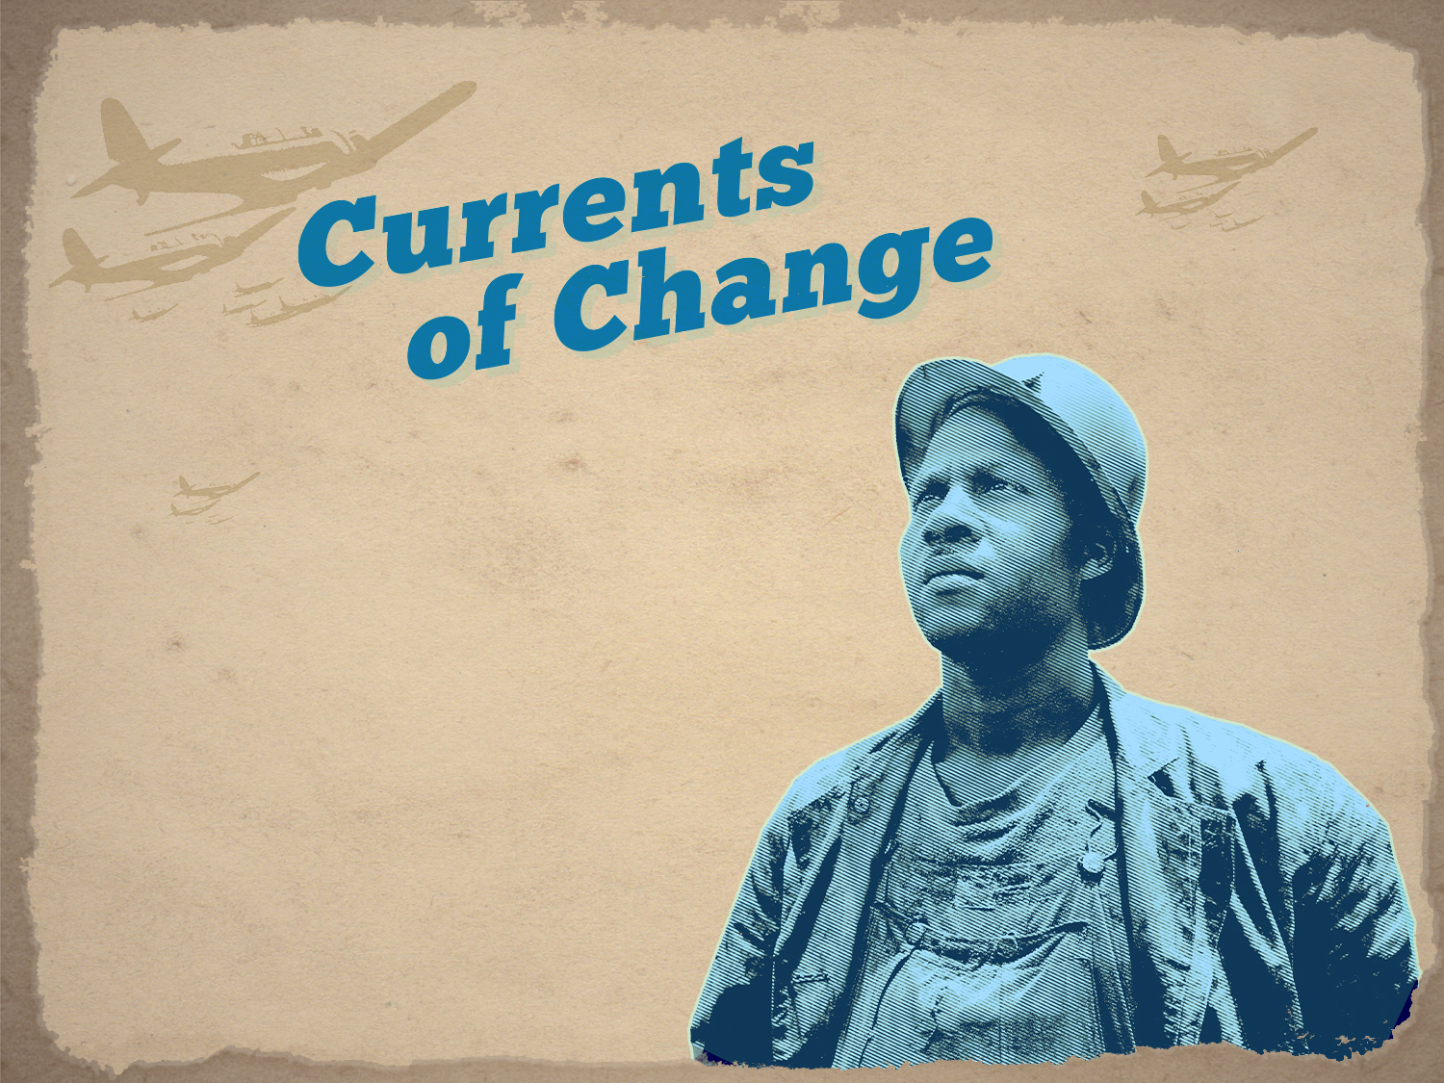
African American
Life & Culture
During World War II

Slide 2

African American Life & Culture
During World War II
INTRODUCTION
During World War II, significant changes occurred in the treatment of African Americans and growing progress in gaining civil and social rights.
The vast changes that World War II brought, while creating some tensions among different groups, gave African Americans the means and the impetus to forge ahead with broad and important advances in integration, opportunity, and social change.
These changes led to the immense power and impact of the Civil Rights Movement of the 1950s and 1960s, culminating in legal equality and opportunity at last.

Slide 3
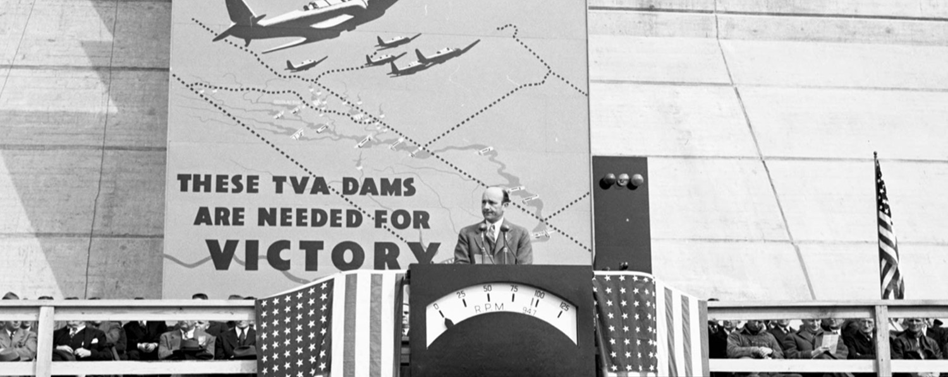
Notes:
What do you think is happening in this photo? There is a man giving a speech for the opening of a dam. (His name was David Lilienthal. He was the chairman of the Board of TVA at the time of the photo).
Which dam? Douglas Dam.
Construction on the dam began in February 1942 and was completed on a crash schedule 12 months later. The dams that were built in the Tennessee Valley helped prepare the area for war by providing much needed electricity. Fontana Dam, Cherokee Dam, and Douglas Dam provided energy to several factories, including Alcoa, the Aluminum Company of America. The dams provided electricity to produce the aluminum that makes the planes that helped win the war.
Look at the sign behind the man.
What do you think “These TVA Dams are needed for Victory” means?

Slide 4
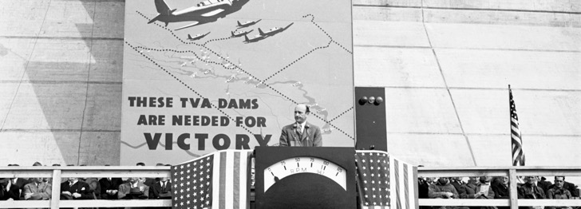
The Tennessee Valley Authority (TVA)
Created in the fast-paced “First 100 Days” of the newly-elected Franklin D. Roosevelt administration in 1933, the TVA was part of FDR’s “relief, recovery, and reform” in his “New Deal” for Americans.
90% of Tennessee Valley residents lacked electricity, leaving residents to store food in cellars or iceboxes, light homes by candle or kerosene lamps, and cook on wood-burning stoves.
Completion and launch of the Cherokee Dam, TN in 1941, two days before Pearl Harbor

Slide 5
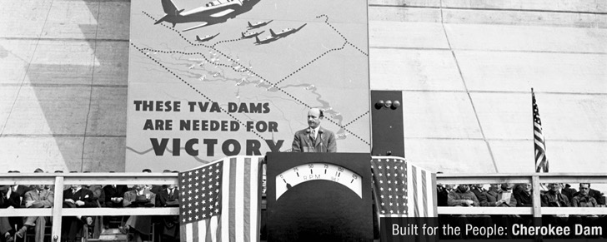
The Tennessee Valley Authority (TVA)
FDR’s administration used the rearmament of America for World War II and the surging industrial production the war effort brought, to bring stronger economic development to the South and the West.
The TVA was the driving force in bringing electrical power to the South and spurring defense plant growth in the region.
Completion and launch of the Cherokee Dam, TN in 1941, two days before Pearl Harbor

Slide 6
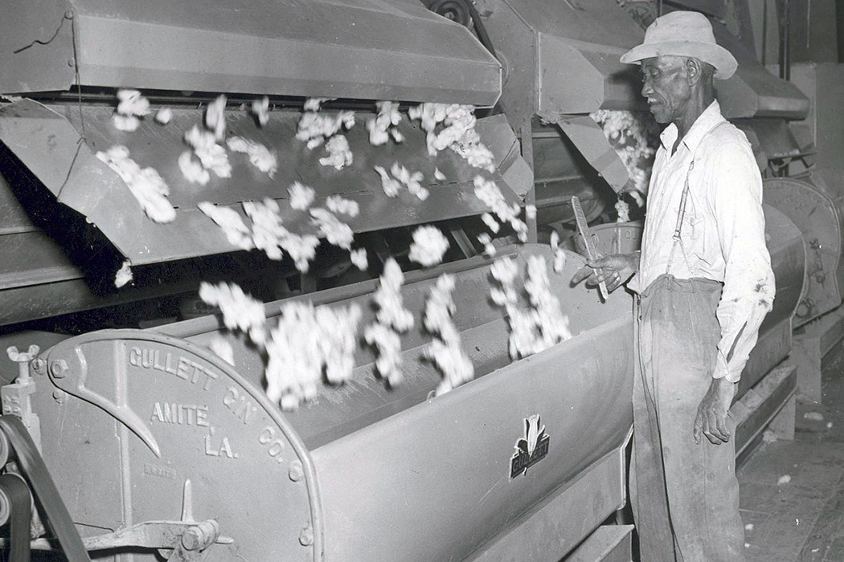
Notes:
What do you see when you look at this photograph?
What is the man doing?
What area of the United States do you think this is in?
Why does cotton grow well in the South?
What kinds of jobs would have been associated with growing cotton in the 1930’s? 1940’s? Today?
How do you think the labor was distributed?

Slide 7

World War II Spurs Economic Growth
in the South
During the Great Depression years of the 1930s, the effects of constant drought, the Dust Bowl, and declining prices for the mainstay crop of the South, cotton, contributed to widespread agricultural and rural unemployment in the Tennessee Valley states and in the South.
A man works a
cotton gin machine
in the 1940s.

Slide 8
World War II Spurs Economic Growth
in the South
The rapid industrialization of America’s economy within days after the Japanese attack on Pearl Harbor on December 7, 1941, quite literally ended the Great Depression.
Within months millions found work in the wartime economy, as well as service in the armed forces.
A man works a
cotton gin machine
in the 1940s.

Slide 9
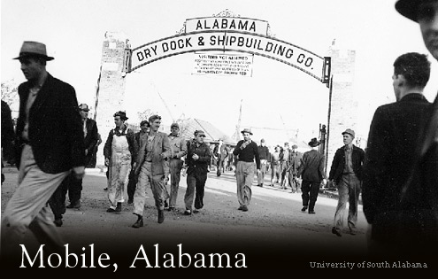
Bias in Employment
The vast array of federal employment and assistance programs of the 1930s had ups and downs in ensuring fair recruitment and hiring of African Americans in the South.
Southern states often secured concessions from the federal government to control the employment and aid programs of the Roosevelt administration.
This often led to bias and a preference for
whites in these programs and in hiring.
White workers leave shipbuilding plant in Mobile, Alabama. African Americans were mostly excluded at first.

Slide 10
Bias in Employment
While white workers found ample work in the defense industries, especially the South, blacks were initially excluded; as well, welfare benefits were often cancelled.
This embittered many African Americans.
A Jim Crow placement system dominated hiring in the South.
White workers leave shipbuilding plant in Mobile, Alabama. African Americans were mostly excluded at first.

Slide 11
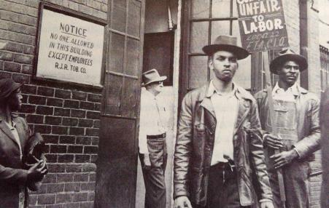
Notes:
What do the signs say in this photograph?
What is Local 22?
What do you think these men were protesting?

Slide 12
Bias in Employment
Prejudice extended to the labeling of most blacks as “unskilled” and included a long-time preference to hire white men first over African Americans and white women.
When jobs were posted, they showed classification by race.
During the 1940s, in North Carolina, a union of tobacco workers fought to bring democracy and fair treatment to the Jim Crow South.

Slide 13
Bias in Employment
African Americans were increasingly frustrated and began to look for a means to end racial inequality in the workplace.
Blacks also began to look to the power of labor unions to affect change.
During the 1940s, in North Carolina, a union of tobacco workers fought to bring democracy and fair treatment to the Jim Crow South.

Slide 14
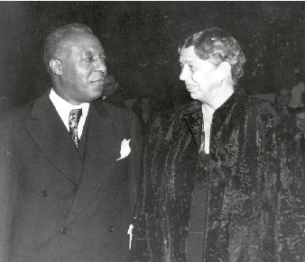
Notes:
Do you recognize anyone in this photo?
Eleanor Roosevelt was Franklin D. Roosevelt’s wife, our First Lady.
The man in the photo is A. Phillip Randolph.

Slide 15
A. Philip Randolph & the Brotherhood
of Sleeping Car Porters & Maids
A powerful and deeply principled president of the black porters’ union, A. Philip Randolph, demanded that Roosevelt issue an executive order that would end Jim Crow policies throughout the South, and to some degree in the North.
In September, 1940 Randolph met with President Roosevelt at the White House and asked FDR to integrate the military and to address discrimination in the defense industry.
The promised follow-up never came and by January, 1941, Randolph was ready to act.
A. Philip Randolph and Eleanor Roosevelt; Convention of the Brotherhood of Sleeping Car Porters and Maids, 1940.

Slide 16
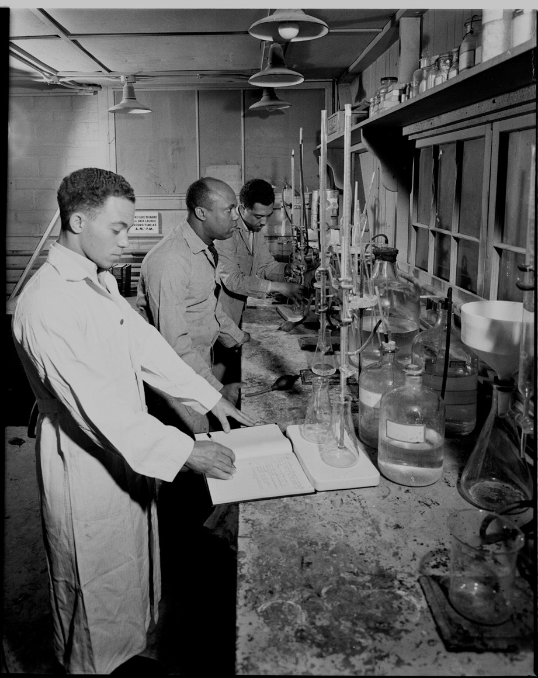
Notes:
What are the men doing in this photo?
How does a job like this differ from jobs that African Americans had during the Great Depression and prior to WWII?

Slide 17
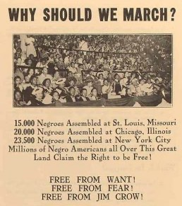
Notes:
Look at this flyer.
What is it advertising?
Read the three “Free from” statements. What do these statements mean?
How important are these statements?

Slide 18
A March on Washington?
African Americans Unite
Not content with FDR’s lack of initiative in ending hiring discrimination, A. Philip Randolph threatened a large march on Washington.
In a second meeting with Roosevelt on June 18, 1941 (following a January 25 meeting), Randolph informed FDR that plans would proceed for a March on Washington if Roosevelt took no action.
FDR did all he could to dissuade Randolph to call off the march, but Randolph held his ground. FDR relented.
Flyer promoting proposed massive
March on Washington

Slide 19
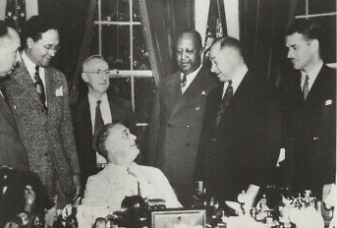
Notes:
Who do you recognize in this photo? (Franklin D. Roosevelt and others)
Do you know why Franklin D. Roosevelt was usually seen sitting?
What do you think these men could be signing?

Slide 20
Executive Order 8802 and
the Fair Employment Practices Committee
Randolph called off the march on Washington, and President Roosevelt issued Executive Order 8802 on June 25, 1941.
The order said there “shall be no discrimination in the employment of workers in defense industries or Government because of race, creed, color, or national origin….And it is the duty of employers and of labor organizations…to provide for the full and equitable participation of all workers in defense industries, without discrimination because of race, creed, color, or national origin.”
President Franklin Roosevelt signs Executive Order 8802

Slide 21
Executive Order 8802 and
the Fair Employment Practices Committee
To enforce this new policy, the Fair Employment Practices Committee (FEPC) was established to investigate complaints of discrimination in any violation of the order.
President Franklin Roosevelt signs Executive Order 8802

Slide 22
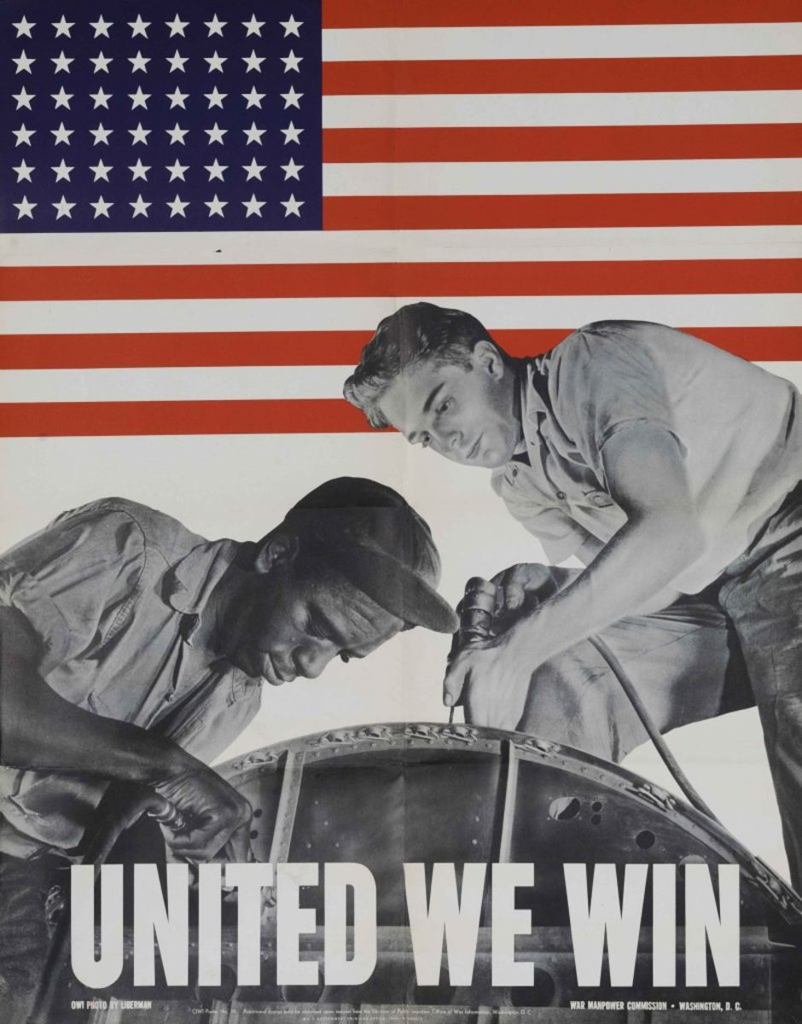
Notes:
What do you see in this photo?
What are the men doing?
What does United We Win mean?

Slide 23
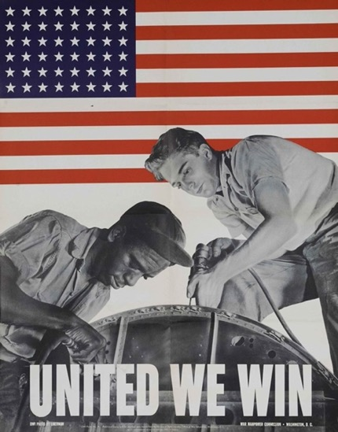
The Southern Response to FEPC &
the “Moral Dilemma”
The FEPC was resisted in the South. For example, the governor of Alabama refused to sign any contract that would force him to abandon a policy of segregation.
Widespread discrimination continued in many parts of the South.

Slide 24
The Southern Response to FEPC &
the “Moral Dilemma”
America-the “arsenal of free world democracy”-found itself in a severe moral dilemma.
The U.S. was giving moral, economic, military, and resource support to nations fighting Nazism, fascism, and Japanese imperialism, yet found itself maintaining discriminatory practices at home.

Slide 25
The Southern Response to FEPC &
the “Moral Dilemma”
Morale among African Americans remained low in the South, sparking First Lady Eleanor Roosevelt to comment that “the nation cannot expect colored people to feel that the United States is worth defending if the Negro continues to be treated as
he is now”.

Slide 26
The Southern Response to FEPC &
the “Moral Dilemma”
“We say glibly that in the United States of America all men are free and equal, but do we treat them as if they were?... There is religious and racial prejudice everywhere in the land, and if there is a greater obstacle anywhere to the attainment of the teamwork we must have, no one knows what it is.”
- Arthur Upham Pope,
Chairman, Committee
for National Morale

Slide 27
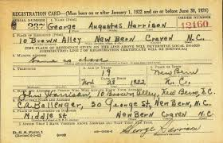
Notes:
What do you see in this photo? (A draft card).
What was the purpose of such a card?
What information do you see on this card?

Slide 28
The Cold Reality of the Tydings Amendment
By 1942 conservative industrialists in the South began to pressure Selective Service boards to give deferments to farm workers, who were in short supply.
Some boards also threatened to draft Mexican farm workers who did not work for a dollar a day!
This power was made law by the (Sen. Millard) Tydings Amendment, which gave selective service boards the legal basis to draft or defer farm workers.
Military draft card, World War II

Slide 29
The Cold Reality of the Tydings Amendment
The unfair nature of this law would be ruled unconstitutional today, but such was the power of the South that employers operated with impunity to secure their needed workers.
African American and Latino workers viewed these laws as a continuation of discrimination and a type of plantation system wedded to Jim Crow.
Military draft card, World War II

Slide 30
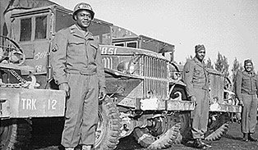
Notes:
What do you see in this photo?
How are the men dressed?
What do you think their job is?
How is this different than jobs African Americans had during the Great Depression?
How do you think they were treated by coworkers and supervisors?

Slide 31
Called to Serve
While African Americans gave generous support to the war effort, such as purchasing bonds, the hiring of black workers was inconsistent and, in the South-in particular-rife with discrimination and exclusion, paired with preferential hiring of whites.
These drivers of the 666th Quartermaster Truck Company, 82nd Airborne Division, chalked up 20,000 miles each without an accident in the European Theater of Operations, 1945

Slide 32
Called to Serve
Although there was much discrimination in the military, blacks had a much greater opportunity to serve their country than in previous wars.
Slowly, African Americans began to make their mark upon America’s armed forces. Across the spectrum of the Army, Navy, and Marines, by 1942 the federal government recognized the value of trained African American soldiers.
Even officer candidate schools opened for African Americans.
These drivers of the 666th Quartermaster Truck Company, 82nd Airborne Division, chalked up 20,000 miles each without an accident in the European Theater of Operations, 1945

Slide 33
Called to Serve
By 1945, almost 1/2 million African Americans were serving in the U.S. armed forces.
Jobs were no longer limited to cooks or low rank personnel, but became more available in most areas.
While units were still segregated, progress was being made.
These drivers of the 666th Quartermaster Truck Company, 82nd Airborne Division, chalked up 20,000 miles each without an accident in the European Theater of Operations, 1945

Slide 34
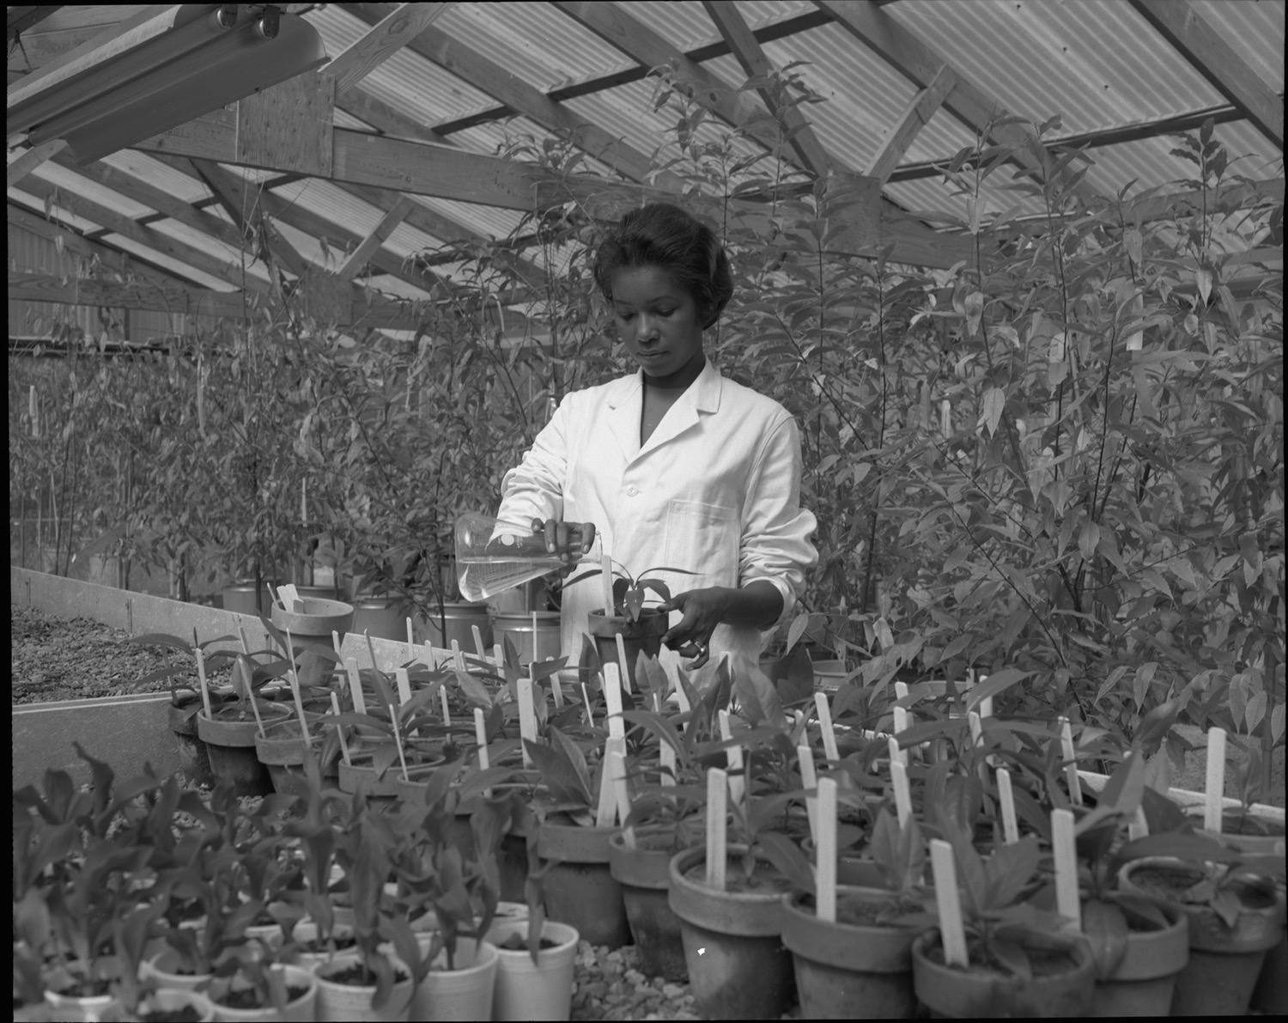
Notes:
What do you see in this photo?
What kind of job do you think this lady is doing?

Slide 35
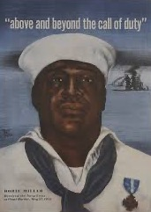
Hero Dorie Miller
Dorie Miller was an American Messman Third Class in the United States Navy.
During the attack on Pearl Harbor December 7, 1941, Miller manned anti-aircraft guns (despite having no formal training in their use) and attended to the wounded.

Slide 36
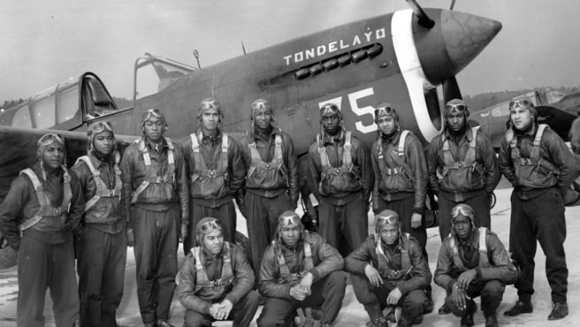
Excellence in the War Effort
More than 3 million African Americans registered for service during World War II.
Standouts include the 332nd Fighter Pilot Squadron in combat in southern Europe and north Africa, the 92nd Division in the Mediterranean theater, 22 black combat units in ground operations
in Europe, and the famed 761st Tank Battalion, which excelled in
the Battle of the Bulge.
Tuskegee Airmen,
Tuskegee, Alabama

Slide 37
Excellence in the War Effort
Better known through modern films and books are the famed Tuskegee Airmen, trained in air combat in Tuskegee, Alabama.
Tuskegee Airmen,
Tuskegee, Alabama

Slide 38
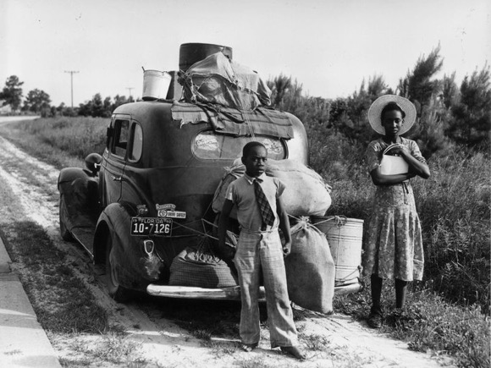
Heading Out North & West
Because of continued segregation of defense industry jobs in the South, 1.6 million blacks went northward and westward during the war to find jobs, distance themselves from segregation, and seek a better life.
World War II offered millions of new jobs all across America.
Florida family migrates north during World War II to seek employment

Slide 39
Heading Out North & West
Despite strong and widespread attempts to keep African Americans from venturing out of the South to find jobs or jobs with better pay, by 1942 the War Manpower Commission began to affirm these attempts and to help non-Southern states recruit black workers from the South.
At last, the federal government began to assist worker mobility, even as African Americans increasingly saw this perceived freedom to choose where to live and work as a civil rights issue.
Florida family migrates north during World War II to seek employment

Slide 40
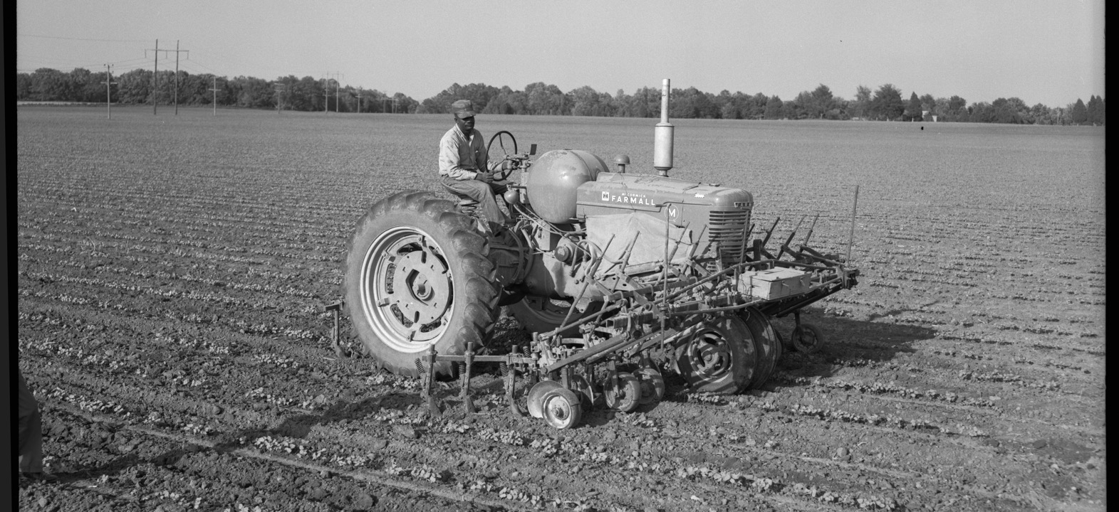
Notes:
What do you see in this photo?
What kind of job do you think this man is doing?

Slide 41
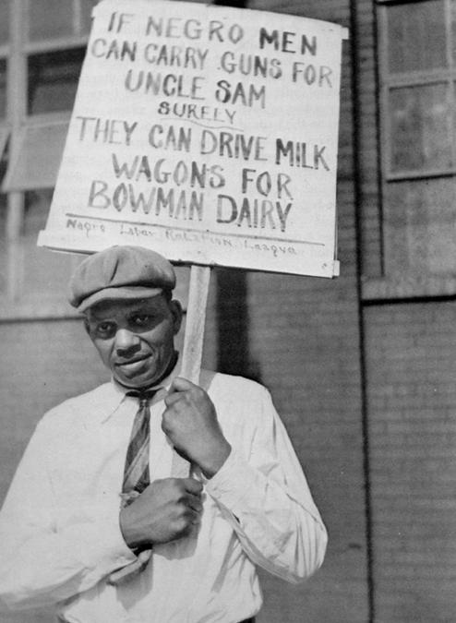
Organized Labor Goes to Bat
for African Americans
To boost wages fair to African Americans and to become more vocal about racial inequality in the workplace, blacks increasingly organized almost every type of industry, including in the South.
With such organizations as the National Urban League, the NAACP, and labor unions working together, along with sympathetic government figures in Washington, D.C., greater economic opportunity-even in segregated unions—came to African Americans throughout the nation and the South.

Slide 42
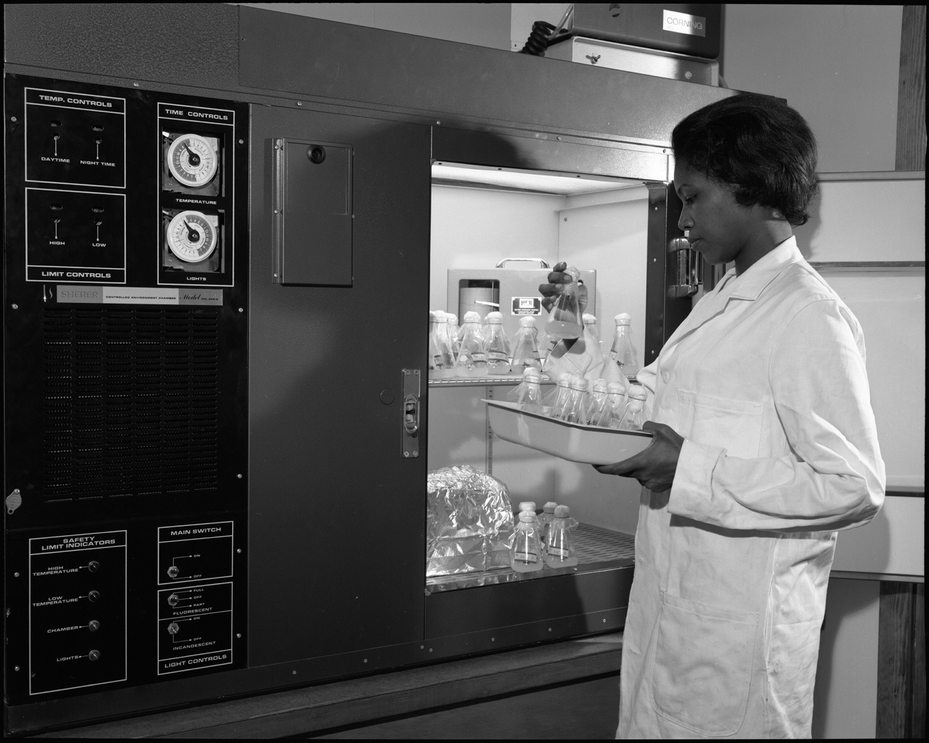

Notes:
What do you see in this photo?
What kind of job do you think this lady is doing?

Slide 43
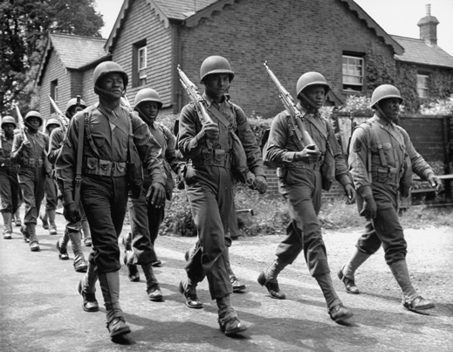
Treatment of Black Soldiers in the South
Outside military training camps in the South, African American soldiers faced Jim Crow discrimination at almost every turn.
In fact, German prisoners of war ate at lunch counters with their white captors, while blacks were excluded or relegated to lesser areas!
In a Kentucky railroad station three African American WACs were beaten by police when the women did not move promptly enough from the waiting room.
These are among hundreds of examples of harsh prejudice against black soldiers in the South, even after the war ended.
African American soldiers,
England, 1900’s

Slide 44
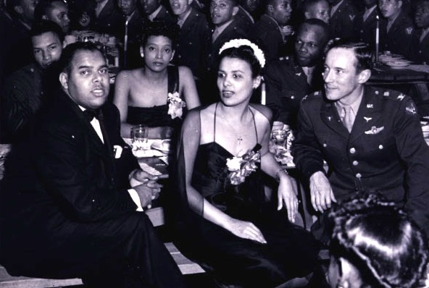
Treatment of Black Soldiers in the South
In the South the famed and storied work of the military’s United Service Organization (USO) was dispensed on a segregated basis, unlike the North where the USO faced no such restrictions.
Famed African American entertainer Lena Horne refused to sing at USO shows or other venues in the South that were not integrated.
Singer and actress Lena Horne at Tuskegee Airfield, Alabama, 1944

Slide 45
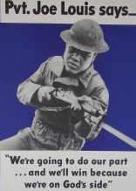
African American Culture During World War II
Recognition of the contributions of African Americans was boosted during World War II due to the eager commitment of blacks to the military and a slow, but increasing recognition of their needed equality and worth in a long-segregated nation.
Besides the determination of such entertainers as Lena Horne to stand up for integration, the power of publicity was recognized with such luminaries as famed boxer Joe Louis, who not only served in the army, but appeared on a military promotional poster in 1942.
Famed boxer and World War II soldier Joe Louis promotes victory effort with U.S. government poster in 1942.

Slide 46
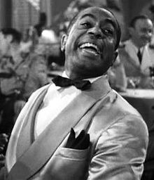
African American Culture During World War II: Film
Before World War II, all-black casts came into their own. Hollywood slowly recognized the importance of portraying African Americans in film, with such characters as Dooley Wilson in Casablanca in 1943.
As blacks were increasingly perceived as just as skilled as whites, their acceptance into the film industry slowly took hold.
Actor Dooley Wilson in the film Casablanca, 1942

Slide 47
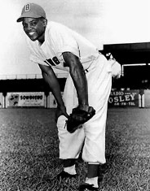
African American Culture During World War II: Baseball
The push to integrate baseball gained momentum during World War II, especially with the death of segregationist Commissioner Kennesaw Mountain Landis in 1944.
Some players, such as Jackie Robinson, had tryouts during the war with major league teams, but integration did not occur till after the war, with Jackie the first in 1947.
Pitching great Satchel Paige, with the Negro League Birmingham Black Barons (1920-1960) in the late 1930s.

Slide 48
African American Culture During World War II: Baseball
The Negro League World Series restarted in 1942 after some years of absence, but finally ended in 1948 with the integration of the Major Leagues.
The so-called Negro Leagues limped through the rest of the 40s and finally ended in the 1950s and early 1960s.
Pitching great Satchel Paige, with the Negro League Birmingham Black Barons (1920-1960) in the late 1930s.

Slide 49
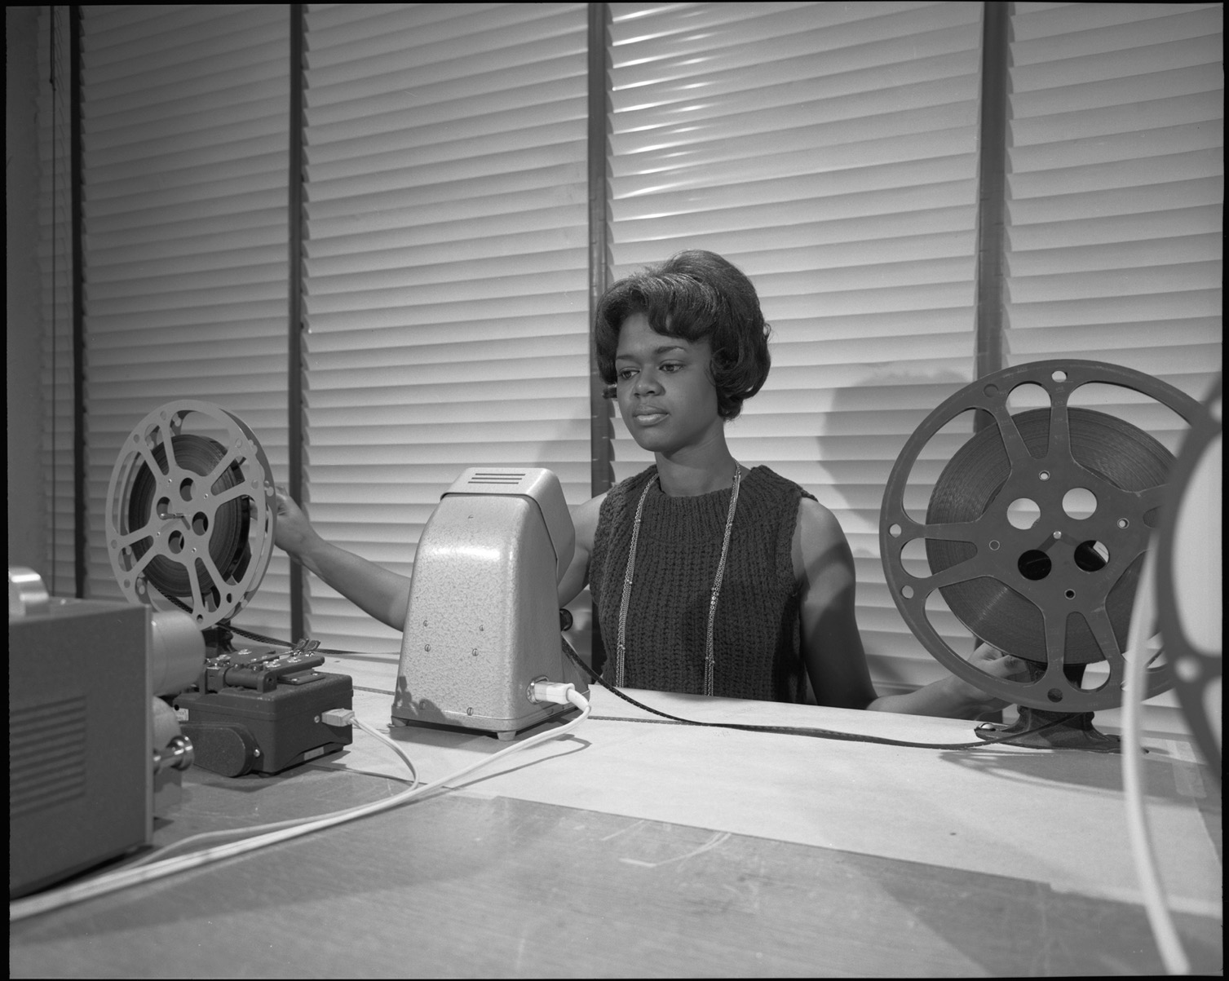
Notes:
What do you see in this photo?
What kind of job do you think this lady is doing?

Slide 50
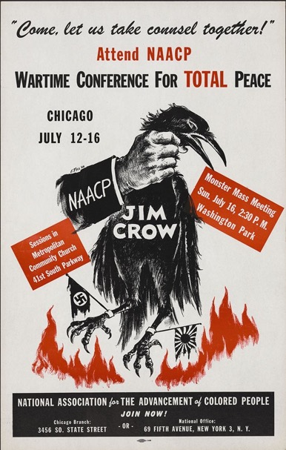
Roots & Rise of the Modern Civil
Rights Movement
Historians point to many pivot points in World War II that could be described as the beginning of the modern Civil Rights Movement, but few would disagree with the proposed march on Washington, D.C. in 1941 from union giant, A. Philip Randolph.
The march never happened, but the call to organize and protest non-violently had gone out with great response.
This was the opening bell to organizing for the advancement of civil rights for African Americans, leading to the bold movement in the 1950s and 1960s.

Slide 51
Roots & Rise of the Modern Civil
Rights Movement
The fight against fascism during World War II brought to the forefront the contradictions between America’s ideals of democracy and equality and its treatment of minorities.
Throughout the war, the NAACP and other civil rights organizations worked to end discrimination in the armed forces.
During this time African Americans became more assertive in their demands for equality in civilian life as well.

Slide 52
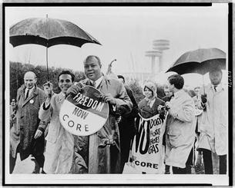
Roots & Rise of the Modern Civil
Rights Movement
The Congress of Racial Equality (CORE), an interracial organization founded to seek change through nonviolent means, conducted the first
sit-ins to challenge the South’s Jim Crow laws.

Slide 53
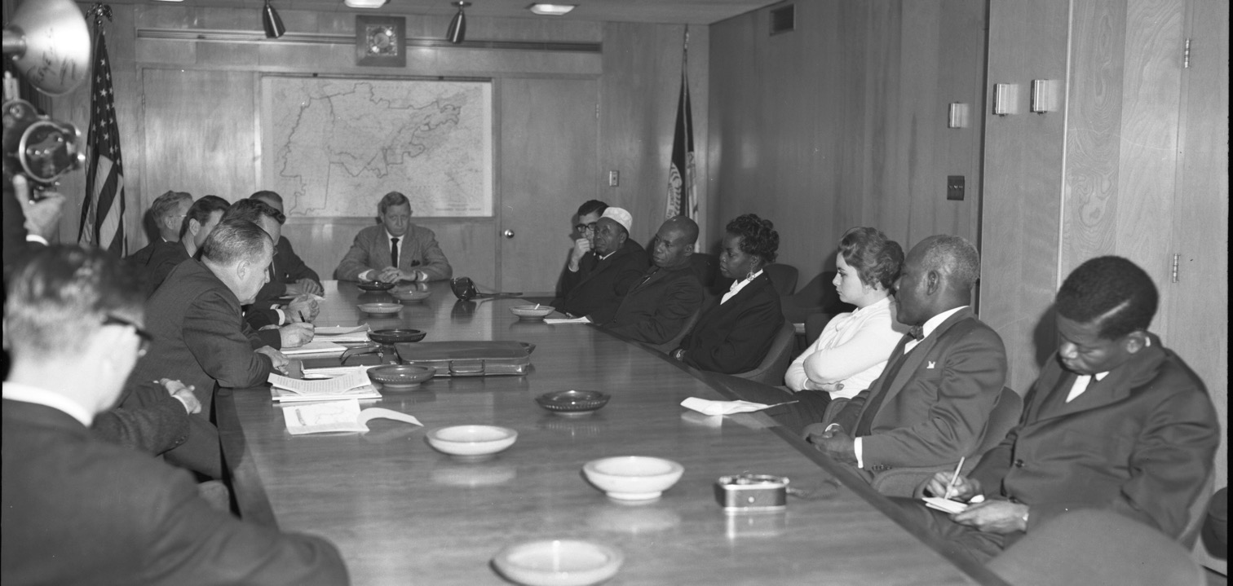
Notes:
What do you see in this photo?
What do you think is going on in this meeting?

Slide 54
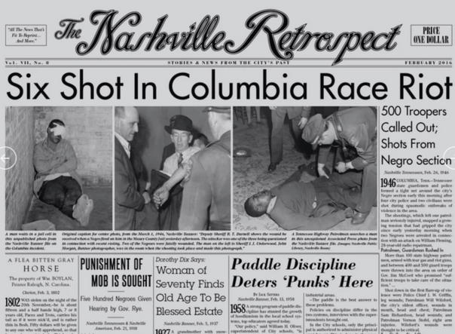
Post-War: Columbia, TN Race Riots
The civil rights movement came crashing down on Tennessee in 1946
in Columbia on the night of February 25-26, 1946.
Like other outbreaks of violence in the South in the immediate postwar era, this incident involved military veterans who were unwilling to accept prevailing racial norms upon returning to their hometowns.
Newspaper headlines (reprint) Nashville, February 26, 1946

Slide 55
Post-War: Columbia, TN Race Riots
Attorney and NAACP Executive Director Thurgood Marshall, America’s first African American on the Supreme Court (1967), defended the accused, who
were either acquitted or had
charges dropped.
Newspaper headlines (reprint) Nashville, February 26, 1946

Slide 56

Post-War: President Truman
Integrates the Military
In a surprise Executive Order, 9981, President Harry Truman integrated the United States Armed Forces on July 26, 1948. Though most Americans opposed integration in 1948-even with the well-known contributions and support of African Americans during World War II in the war effort—Truman bucked popular opinion and issued this order:
“It is hereby declared to be the policy of the president that there shall be equality of treatment and opportunity for all persons in the armed services without regard to race, color, religion or national origin. This policy shall be put into effect as rapidly as possible, having due regard to the time required to effectuate any necessary changes without impairing efficiency or morale.”
PLAY SPEECH
The march to gain full equality & opportunity began to gain momentum and carried all the way to the great changes of the 1960s in ensuring equal and fair treatment for minorities and laws to enforce change, such as the Civil Rights Act 1964 and the Voting Rights Act 1965.

Slide 57
References
Black History Now.com “Asa Philip Randolph”.
[Online]: http://blackhistorynow.com/asa-philip-randolph/
Franklin, John Hope and Moss, Alfred A., Jr. (2005). From Slavery to Freedom. A History of African Americans (Eighth Edition). Alfred A. Knopf, New York.
French, Yvonne. Library of Congress. (April 3, 1995). When Opportunity Began to Knock. African Americans During World War II and the Depression. [Online]: http://www.loc.gov/loc/lcib/9507/aamericans.html
George Washington University. “Eleanor Roosevelt Papers: About Human Rights”
[Online]: https://wWorld War II.gwu.edu/~erpapers/workers/articles/labback2.htm
Gershon, Livia. (March 13, 2017). Jstor Daily. “Automation in the 1940s Cotton Fields”.
[Online]: https://daily.jstor.org/automation-in-the-1940s-cotton-fields/
Library of Congress. Great Depression and World War II, 1929-1945. Race Relations in the 1930s and 1940s.
[Online]: http://www.loc.gov/teachers/classroommaterials/presentationsandactivities/presentations/timeline/depwwii/race/
Marrin, Albert. (2015). FDR and the American Crisis. Alfred A. Knopf, New York.
Marx, J.D. (2011). American social policy in the Great Depression and World War II.
[Online]: http://socialwelfare.library.vcu.edu/eras/great-depression/american-social-policy-in-the-great-depression

Slide 58
References
Miller Center, University of Virginia. (September 1, 1940). “Office Conversation with A. Philip Randolph”.
[Online]: https://millercenter.org/the-presidency/secret-white-house-tapes/office-conversation-philip-randolph
National Archives. “Powers of Persuasion”
[Online]: https://www.archives.gov/exhibits/powers_of_persuasion/united_we_win/united_we_win.html
National Archives. (September 25, 2013). “What Effect Did the World War II Fair Employments Practices Commission Have on the Civil Rights Movement?”
[Online]: https://education.blogs.archives.gov/2013/09/25/fair-employment-practices-commission/
PBS. “The War”
[Online]: https://www.pbs.org/thewar/the_witnesses_towns_mobile.htm
Politico. ((July 26, 2018). “Truman ends segregation in armed forces July 26, 1948.
[Online]: https://www.politico.com/story/2018/07/26/this-day-in-politics-july-26-1948-735081
Portside.org. (June 3, 2018). “Civil Rights Unionism”.
[Online]: https://portside.org/unions?page=5
Tennessee Valley Authority. “TVA Goes to War”
[Online]: https://www.tva.gov/About-TVA/Our-History/The-1940s
Van West, Carroll. “Columbia Race Riot” Tennessee Encyclopedia.
[Online]: https://tennesseeencyclopedia.net/entries/columbia-race-riot-1946/
Zinn Education Project. “Jan 25, 1941: A Philip Randolph and March on Washington”.
[Online]: https://www.zinnedproject.org/news/tdih/a-philip-randolph-first-call-mow/

Slide 59
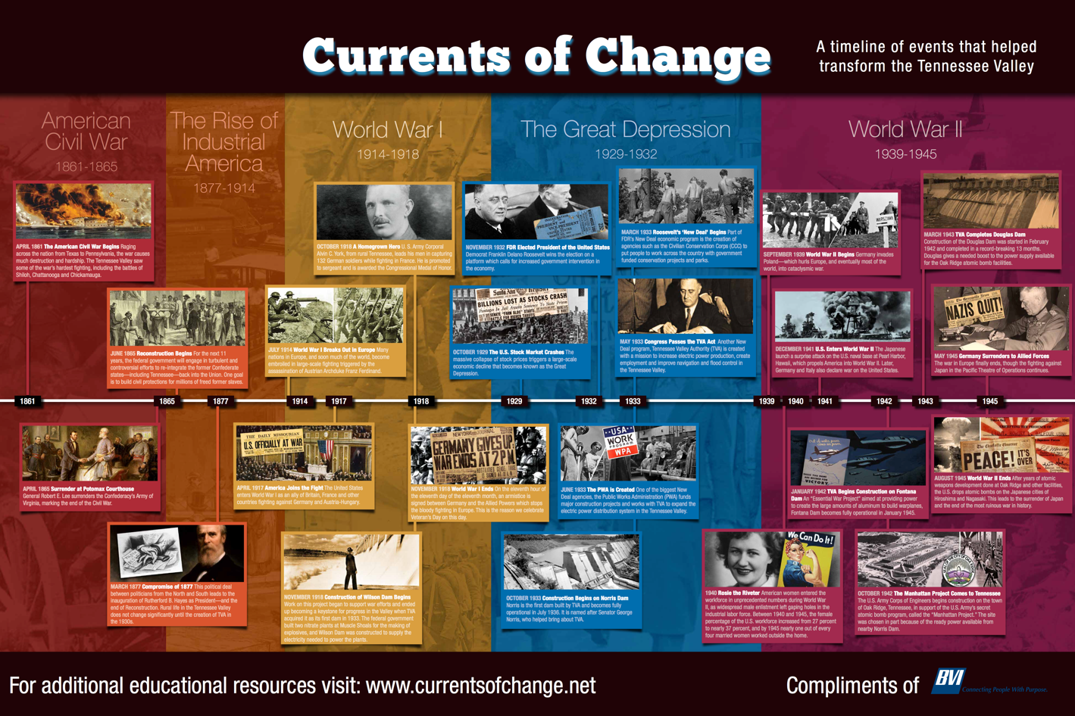
Notes:
This poster helps students see where the Great Depression occurred in relation to other historical eras in US History. For a FREE Timeline of Historical Events poster for your classroom, go to www.currentsofchange.net . Click on “About” and request your free poster.

Slide 60
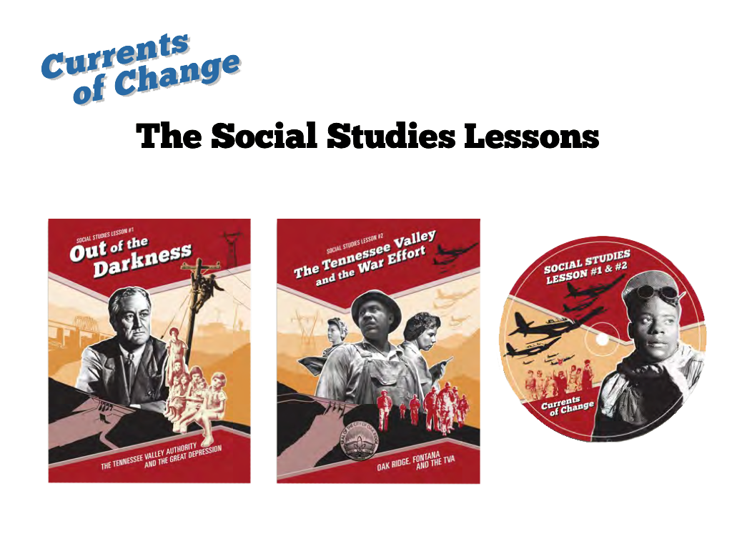
Notes:
Please check out our website, www.currentsofchange.net, for these two awesome Tennessee Valley US History lessons as well as our many other resources.

